Slide 1
Using Images with HTML
Embedding images within an Html Document
The image object and accessing Images within Script
Images and Caching
Creating Image Rollover Effects

Slide 2
Embedding images within an Html Document
Images are embedded within a web page with the use of IMG tag.
This tag contains the source of the image file and other information, and does have an end tag.
The image formats
The Graphics Interface Format (GIF) is the most popular image format in use within html files.
The GIF89a version allows for the specification of the number of colors to include within the image file.
The Joint Photographic Experts Group (JPEG) format retains all the image’s colors – but also supports a compression technique that discards data from the image nonessential to the display.

Slide 3
Embedding images within an Html Document
Higher levels of compression lead to smaller file sizes, but also decrease the quality of the image.
The Portable Network Graphics (PNG) format is considered a replacement for the GIF format.
PNG supports a more efficient compression routine and two-dimensional interlacing, which controls how an image is displayed while it downloads.

Slide 4
The IMG Attributes
Images are embedded within a web page using the IMG tag.
<img src=flowes.gif width=100 height=100 alt=“Flowers are very Beautiful” hspace=20>
Attributes supported for IMG tag are:
src – URL of the image source file
alt - alternative text
Align – how image aligns, deprecated
Height – height to reserve for image, deprecated
Width - width to reserve for image, deprecated
Border - size of border surrounding image, deprecated
Hspace – horizontal white space on either side of image, deprecated
Vspace - vertical white space on either side of image, deprecated

Slide 5
The IMG Attributes
Id - image name
Class - style sheet class
Style - style sheet information
Title - element title

Slide 6
The IMG Width and Height Attributes
The width and height of the image define the area of the window the image occupies.
The same image object with different widths and heights
<img src=logo.jpg width=100 height=100>
<img src=logo.jpg width=50 height=50>
<p>
<img src=logo.jpg width=300 height=300>
<img src=logo.jpg width=200 height=150>

Slide 7
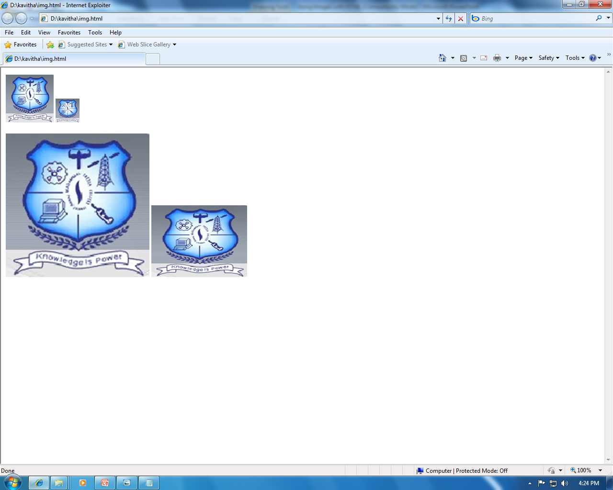
The IMG Width and Height Attributes

Slide 8
The alt Attribute
Alt attribute provides alternative text for the browsers that do not pick up images.
<img src=flower.jpg alt=“ Flower – Rose”>

Slide 9
The image object and accessing images within script
The image object is accessed by creating a new image object or by accessing the images embedded into the web page via the image array.
Each img tag within the web page is associated with one entry in the images array.
Example
<html>
<head>
<title> Images </title>
<script language=“javascript”>
Function change_image(num)
{
Var img=“ “;

Slide 10
The image object and accessing images within script
if(num==1)
img = “photo7.jpg”;
Else if(num==2)
img = “photo8.jpg”;
Else if(num==3)
img = “photo9.jpg”;
Else
img = “photo10.jpg”;
Document.images[0].src=img;
}
</script>
</head>
<body>
<form name=f1>
<img src=“photo7.jpg”>

Slide 11
The image object and accessing images within script
<input type=radio name=r1 value=one onclick=“change_image(1)”> one
<input type=radio name=r1 value=one onclick=“change_image(2)”> Two
<input type=radio name=r1 value=one onclick=“change_image(3)”> Three
<input type=radio name=r1 value=one onclick=“change_image(4)”> Four
</form>
</body>
</html>

Slide 12
The image object properties, accessed via image array
Src - image URL
Width - image width
Height - image height
Lowsrc - lowsrc image’s url, first displayed when page is opened.
Hspace - horizontal space
Vspace - vertical space
Border - border width
Name - image name
Complete - whether image has completed loading.

Slide 13
Images and Caching
When you access an image for the first time, the image must be downloaded from the server.
After the image is downloaded, though, it is cached on the client machine and subsequent accesses to the image pull it from the cache rather than the server.
Example
<html> <head> <title> images </title>
<script language=javascript>
image_array = new array(4);
For(i=0; i<image_array.length; i++)
image_array[i] = new image(100,150);
image_array[0].src = “photo7.jpg”;
image_array[1].src = “photo8.jpg”;
image_array[2].src = “photo9.jpg”;

Slide 14
Images and Caching
image_array[4].src = “photo10.jpg”;
Function change_image(num)
{ document.images[0].src = image_array[num].src; }
</script>
</head>
<body>
<form name=f1>
<img src=“photo7.jpg”>
<input type=radio name=r1 value=one onclick=“change_image(1)”> one
<input type=radio name=r1 value=one onclick=“change_image(2)”> Two
<input type=radio name=r1 value=one onclick=“change_image(3)”> Three
<input type=radio name=r1 value=one onclick=“change_image(4)”> Four
</form>
</body>
</html>

Slide 15
Creating Image Rollover Effects
The most popular use of changing images is to create a rollover effect for images that represent active links.
When the reader moves the mouse over the image, the image takes on a different appearance, adding a highlight that provides feedback to the reader.
Roll over with mouse down and mouse up events
<html>
<head> <title> images </title>
<script language=“javascript”>
Highimage = new image(106,157);
Lowimage = new image(106,157);
Lowimage.src = “optnrm.jpg”;
Highimage.src = “pothigh.jpg”;

Slide 16
Creating Image Rollover Effects
Function change_high(num)
{ document.images[num].src = highimage.src. }
Function change_low(num)
{ document.images[num].src = lowimage.src. }
</script> </head>
<body>
<a href=“” onmousedown=“change_high(0)” onmouseup=“change_low(0)”> <img src=“optnrm.jpg”width=106 height=157 hspace=10> </a>
<a href=“” onmousedown=“change_high(1)” onmouseup=“change_low(1)”> <img src=“optnrm.jpg”width=106 height=157 hspace=10> </a>
<a href=“” onmousedown=“change_high(2)” onmouseup=“change_low(2)”> <img src=“optnrm.jpg”width=106 height=157 hspace=10> </a>
</body.
</html>

